Slide 1
Test your skills…..

Slide 2
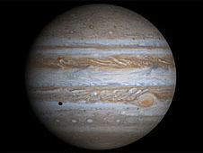
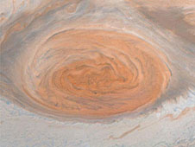
Jupiter is the largest planet in our Solar system According to NASA, you could fit 1000 Earths into it! The Great Red Spot is a hurricane on the planet twice the size of Earth.
Find the ratio of the size of the
Great Red Spot to that of Jupiter.

Slide 3
Black holes are some of the strangest and most fascinating objects found in outer space. They are objects of infinite density, with such strong gravitational attraction that even light cannot escape from their grasp if it comes near enough!

Slide 4
When a star burns through the last of its fuel,
it may find itself collapsing. For smaller stars,
up to about three times the sun's mass,
the new core will be a neutron star or a white dwarf.
But when a larger star collapses,
it continues to fall in on itself to create a stellar black hole.

Slide 5
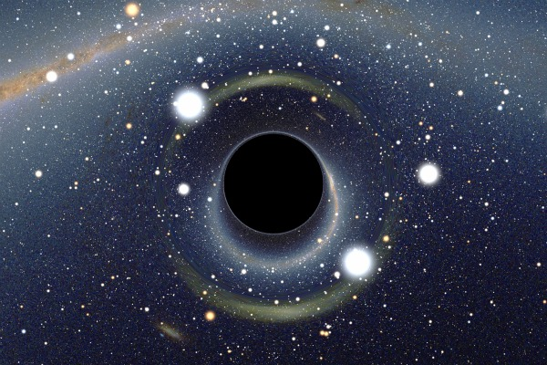
Who was the first person to predict the existence
of black holes?
Of course, it was Albert Einstein!

Slide 6
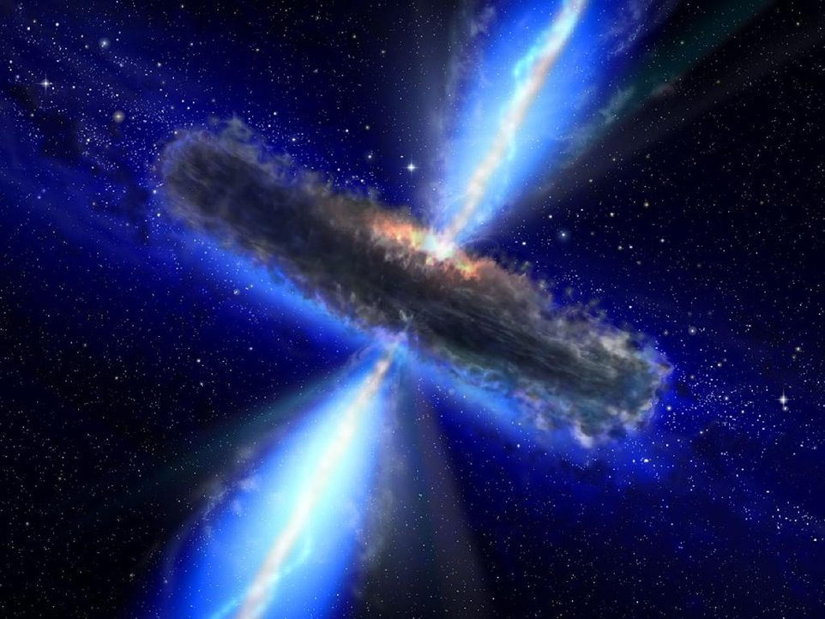
Quasars are very energetic active galactic nuclei, powered by supermassive and super-active black holes at the center of galaxies.

Slide 7
Now, think of a new Quasar. Let’s name it XYZ. Imagine 10 asteroid arms, each of length 50 billion km, revolving around the black hole. If , at a given time, the black hole consumes 50 million km from each arm, what is the total length of all the arms after consumption?
*Remember: The information above is NOT authentic. We’re only assuming.

Slide 8
A comet is an icy body that releases gas or dust. Comets orbit the sun, but most are believed to inhabit in an area known as the Oort Cloud, far beyond the orbit of Pluto. Occasionally a comet streaks through the inner solar system; some do so regularly, some only once every few centuries.
A very famous comet is Halley’s Comet, which travels near our planet every 74 to 79 years. Do you know the connection between this comet and Mark Twain’s life?

Slide 9
Let’s now assume—and only assume—that a new comet , call it ABC, orbits a star. If it completes one revolution every 175 years, and the distance it travels in 1 year is 2 million km, how much would it have travelled if it were halfway to the completion to its second revolution?

Slide 10
Meteors are small chunks of space debris that hit a planet.

Slide 11
Suppose one such meteor hits a planet and devastates ¼ of it. What would happen if a meteor double the size of the one mentioned before travels at the same speed and hits a planet 4 times the mass of the previously mentioned one?

Slide 12
Some useful links: 1.http://www.space.com/9116-halley-comet-spotted-ancient-greeks.html 2. http://www.space.com/15353-meteor-showers-facts-shooting-stars-skywatching-sdcmp.html 3.http://www.geocities.com/lauferworld.geo/Twain.htm 4. http://solarsystem.nasa.gov/planets/profile.cfm?Object=Jupiter&Display=Overview 5. http://www.space.com/15421-black-holes-facts-formation-discovery-sdcmp.html

Slide 13
The End
By Alina Nawab Kidwai, Grade 9 C

