Slide 1
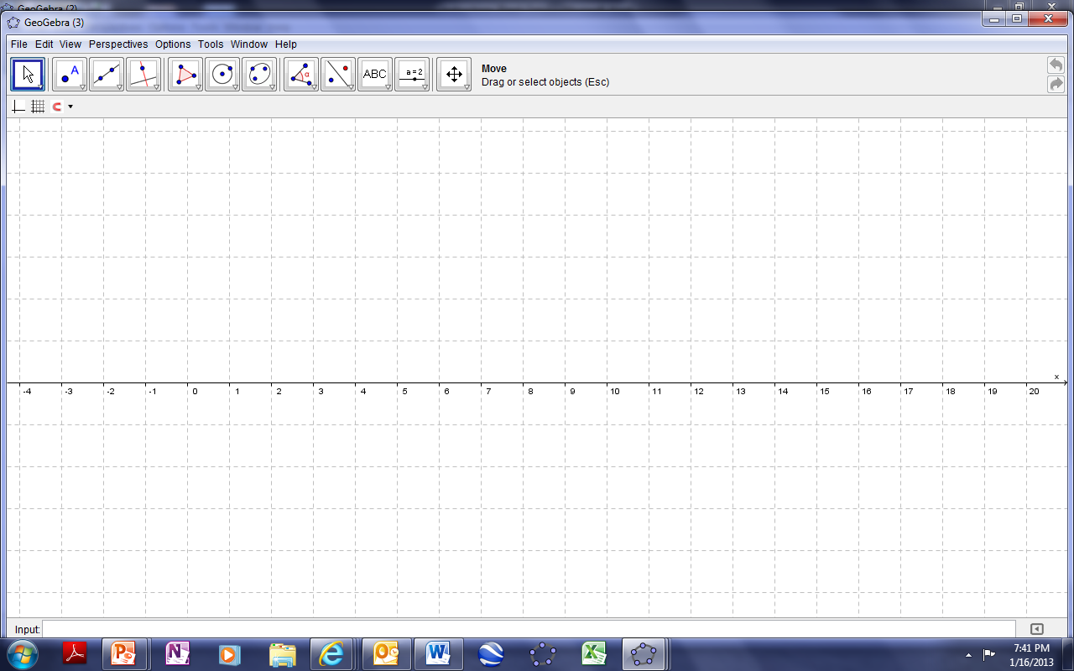
Open the Geogebra window.

Slide 2
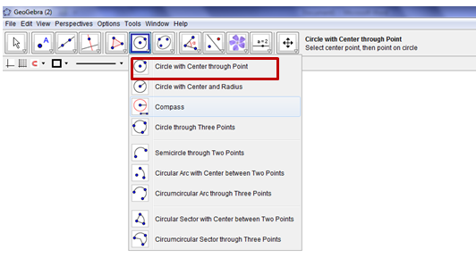
1. Draw a circle with centre through a point.

Slide 3
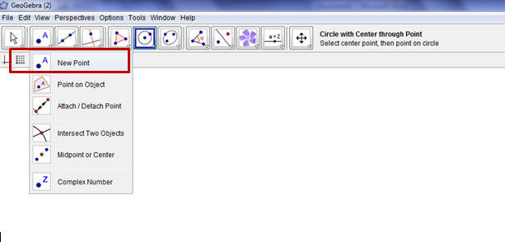
2.Mark two points on the circle using New point tool

Slide 4
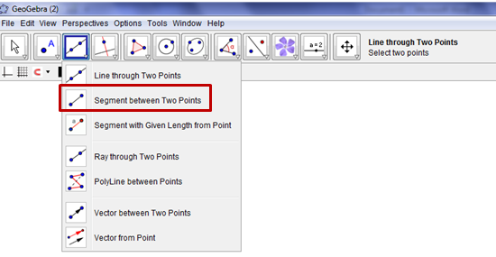
3.Construct a chord joining these points using segment between two points.

Slide 5
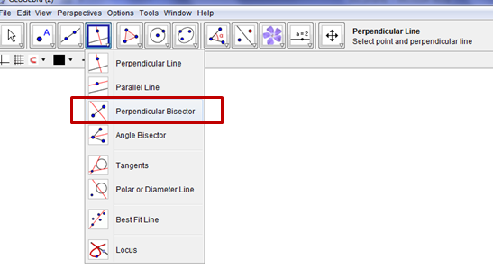
4. Draw the perpendicular bisector of the chord using perpendicular bisector tool.

Slide 6
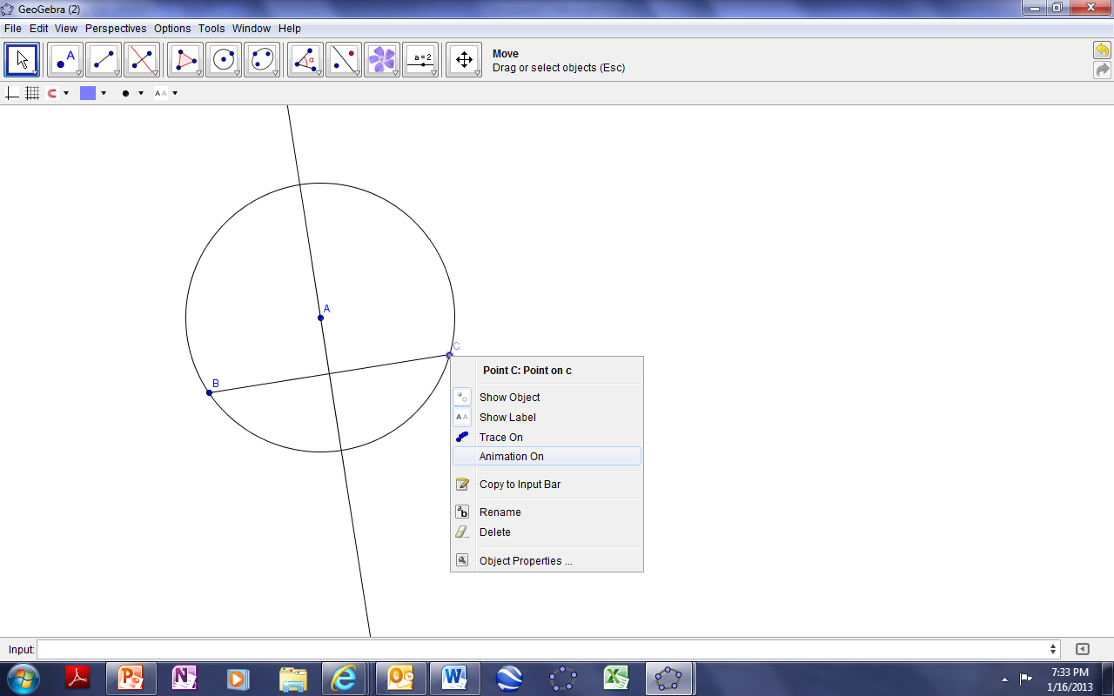
5. What Could you observe? Is your guess true for any chord? Right click after selecting an end point of the chord and choose animation on .

Slide 7
Frame a a statement based on your observation.
6. Select the text box given below and change the font colour to check the result. I am sure that the result you frame is correct.
The perpendicular bisector of any chord of a circle passes through the centre of the circle.
7. If you have any doubt, watch the video given in the blog
Mrs. Sajna Santhosh, HOD Mathematics, OOIS

