Slide 3
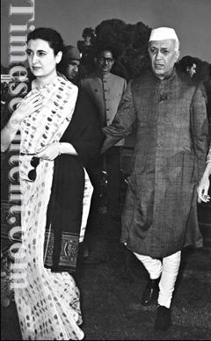
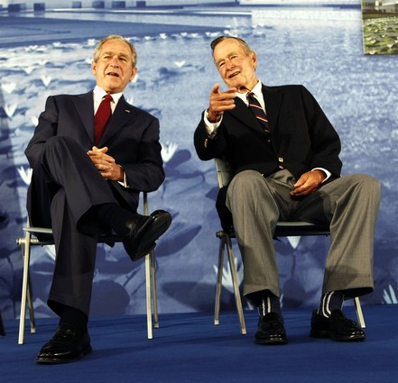
x
y
x
y
y
x
Y
x

Slide 4
( x , y )
( 2 , 5 )
y = x+3
y is …………………………………………..
y =
y = x ³ - 3
y = 5x-5
y = 6x-7
y = 2x ² - 3
y = 4x-3
y = 3x-1
y = 2x+1
y = x ² + 1
Mrs.SAJNA SANTOSH,OOIS

Slide 5
Learning objectives
The students will be able to
Identify the relationship between the co ordinates
Frame the equation connecting the co ordinates
Check whether all the points on the graph satisfy the equation of the graph
Generalise the nature of the graph

Slide 6
Team A
(0 , 1 )
( 1 , 4 )
( 2 , 7 )
( 3 , 10 )
( 4 , 13 )
Team B
(0 , 1 )
( 1 , 3 )
( 2 , 5 )
( 3 , 7 )
( 4 , 9 )
Team C
(0 , 2 )
( 1 , 3 )
( 2 , 4 )
( 3 , 5 )
( 4 , 6 )
Team D
(0 , -1 )
( 1 , 1 )
( 2 , 3 )
( 3 , 5 )
( 4 , 7 )

Slide 7
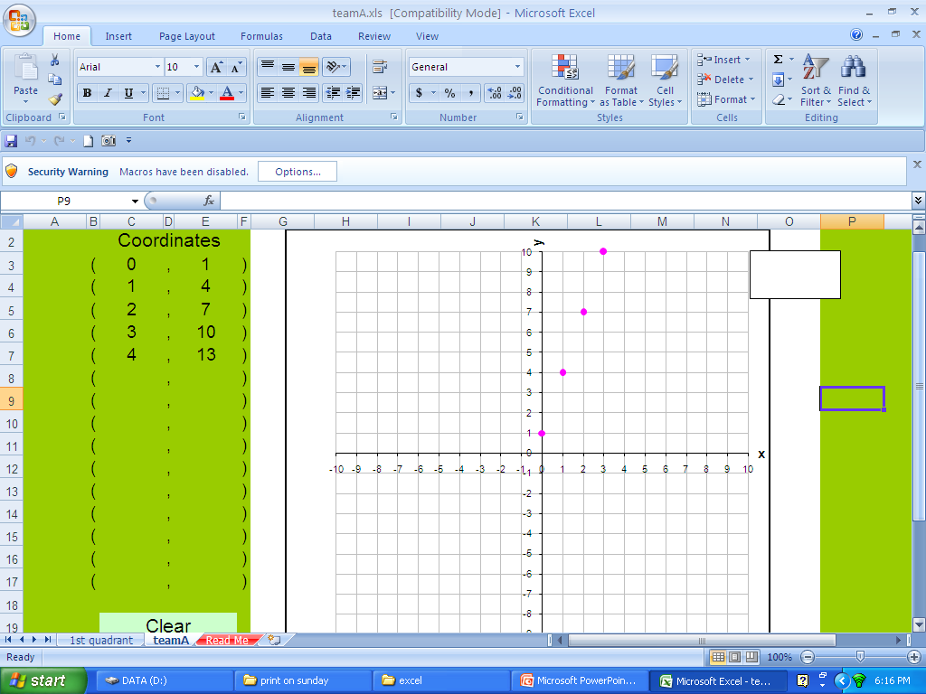
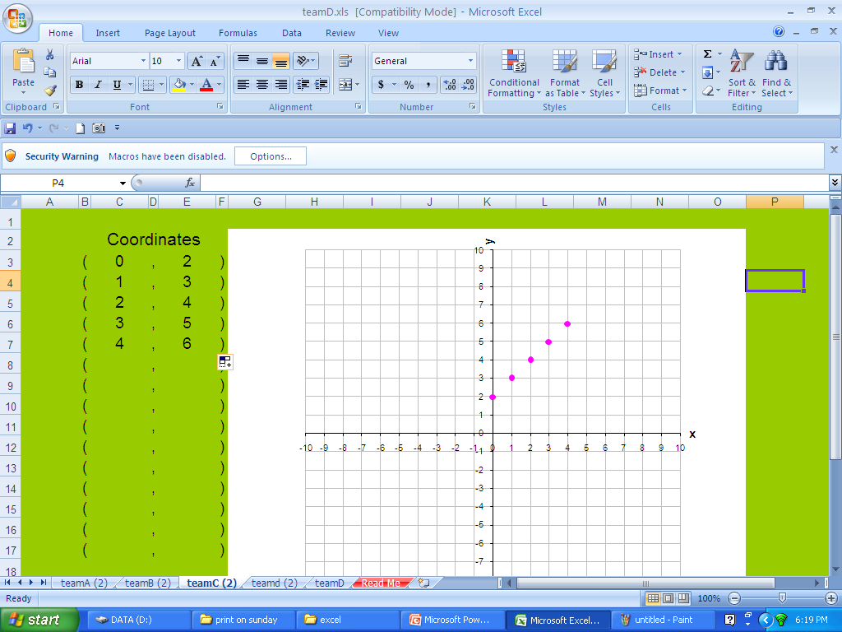
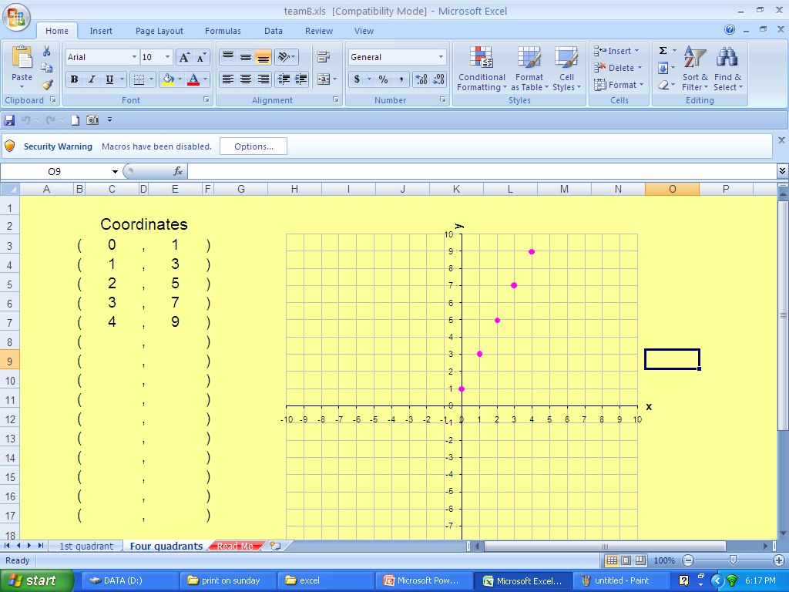
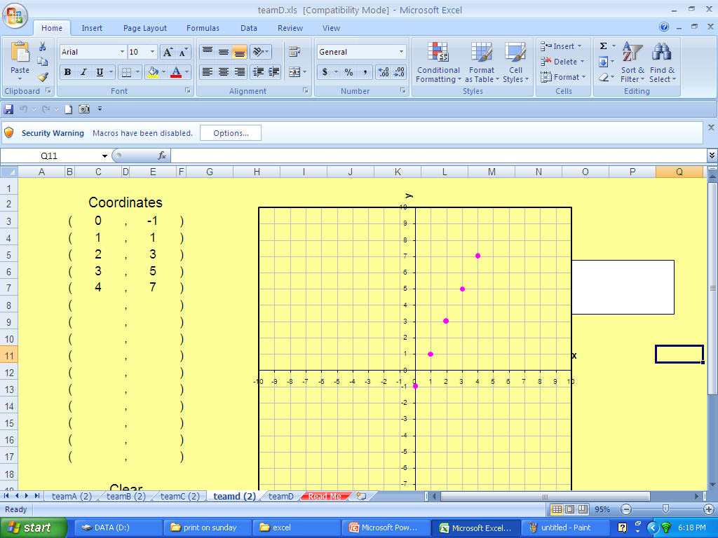

Slide 9
(0 , 1 )
( 1 , 4 )
( 2 , 7 )
( 3 , 10 )
( 4 , 13 )
(0 , 1 )
( 1 , 3 )
( 2 , 5 )
( 3 , 7 )
( 4 , 9 )
(0 , 2 )
( 1 , 3 )
( 2 , 4 )
( 3 , 5 )
( 4 , 6 )
(0 , -1 )
( 1 , 1 )
( 2 , 3 )
( 3 , 5 )
( 4 , 7 )
y= 3 x +1 y=2x +1 y = 1x + 2 y = 2x – 1

Slide 10
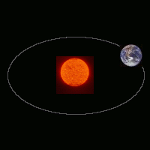
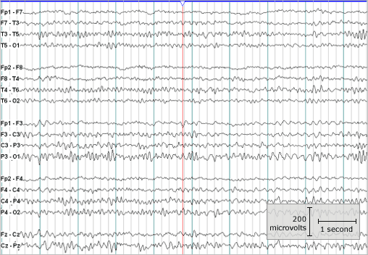
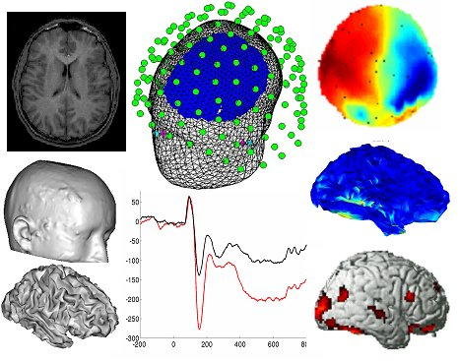
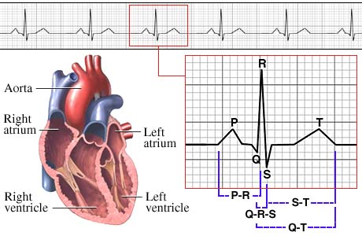
GRAPH

Slide 11
